Slide 2
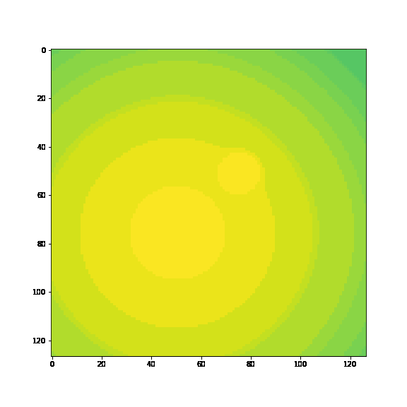
Multiscale in space and time. Toy1 is
2 times scales, 2 space scales

Slide 3
Having some trouble completely understanding MrCAE
How small should I compress down? It looks like Yuying’s code cuts in half every layer, toy1 has 3 layers. (smallest one he uses is 31x31 biggest 127x127)
I think I should start a lot smaller than this.

Slide 4
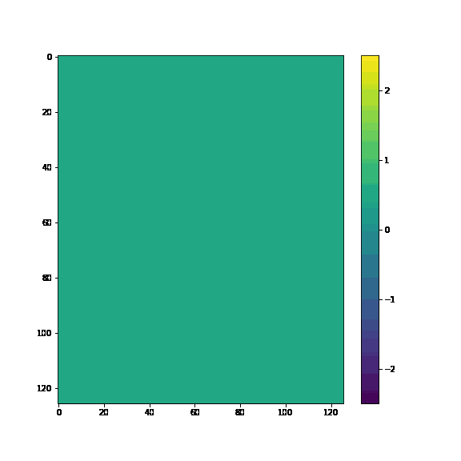
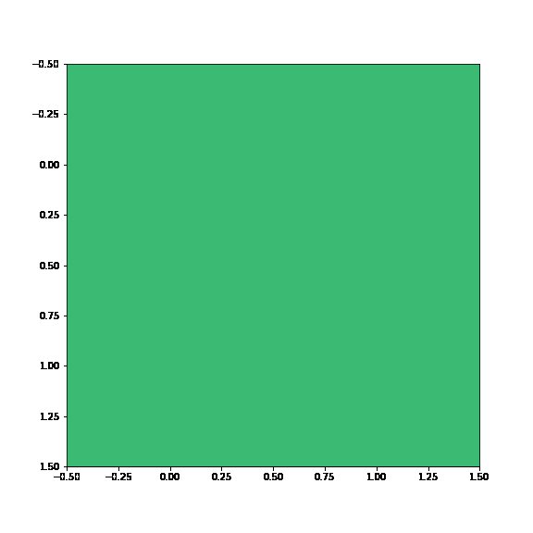
Using simple conv to predict to 2x2
Data on a 2x2 grid, these are the averages of each block

Slide 5
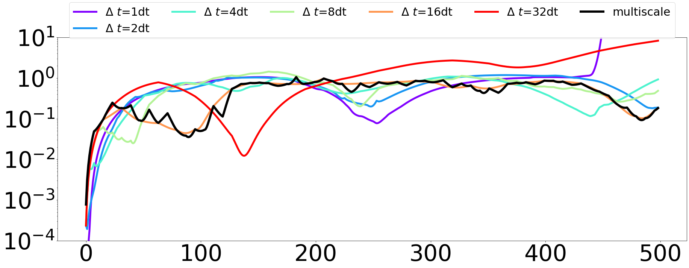
Predicting in time of a 2x2
Picked models 3 & 4
These are the error on the 2x2 not the whole system
2x2 data is using the average of each block

Slide 6
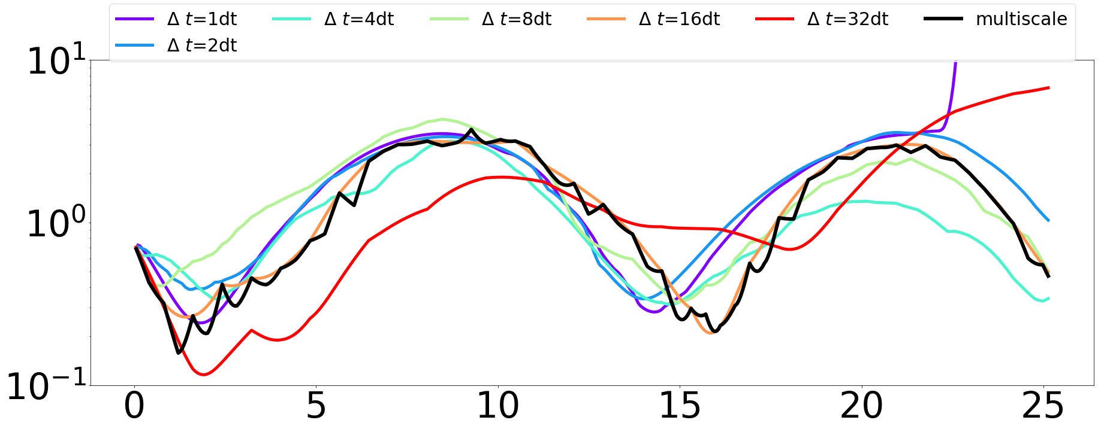
This is the error when we transform back to 126x126

Slide 7
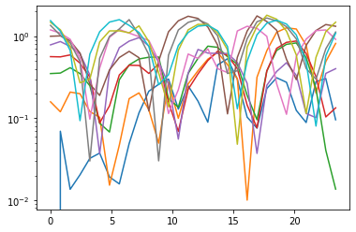
The 10 test runs (average of these is what’s in black in pervious slide ) 2x2

Slide 8
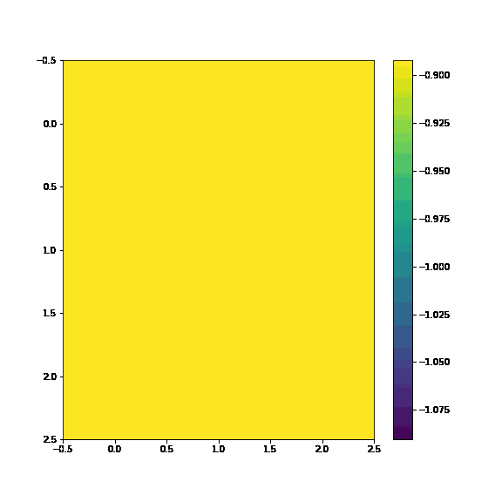
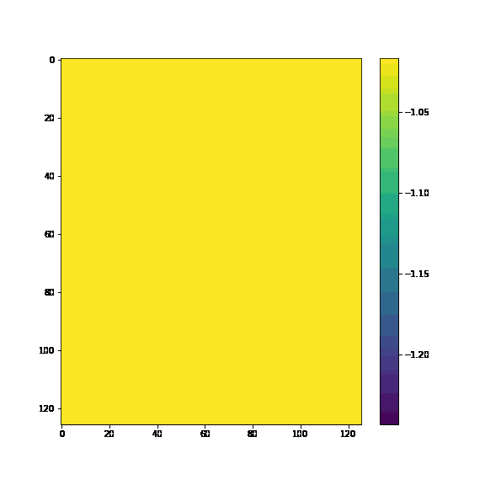
Also on 3x3
3x3 averages
3x3 simple autoencoder

Slide 9
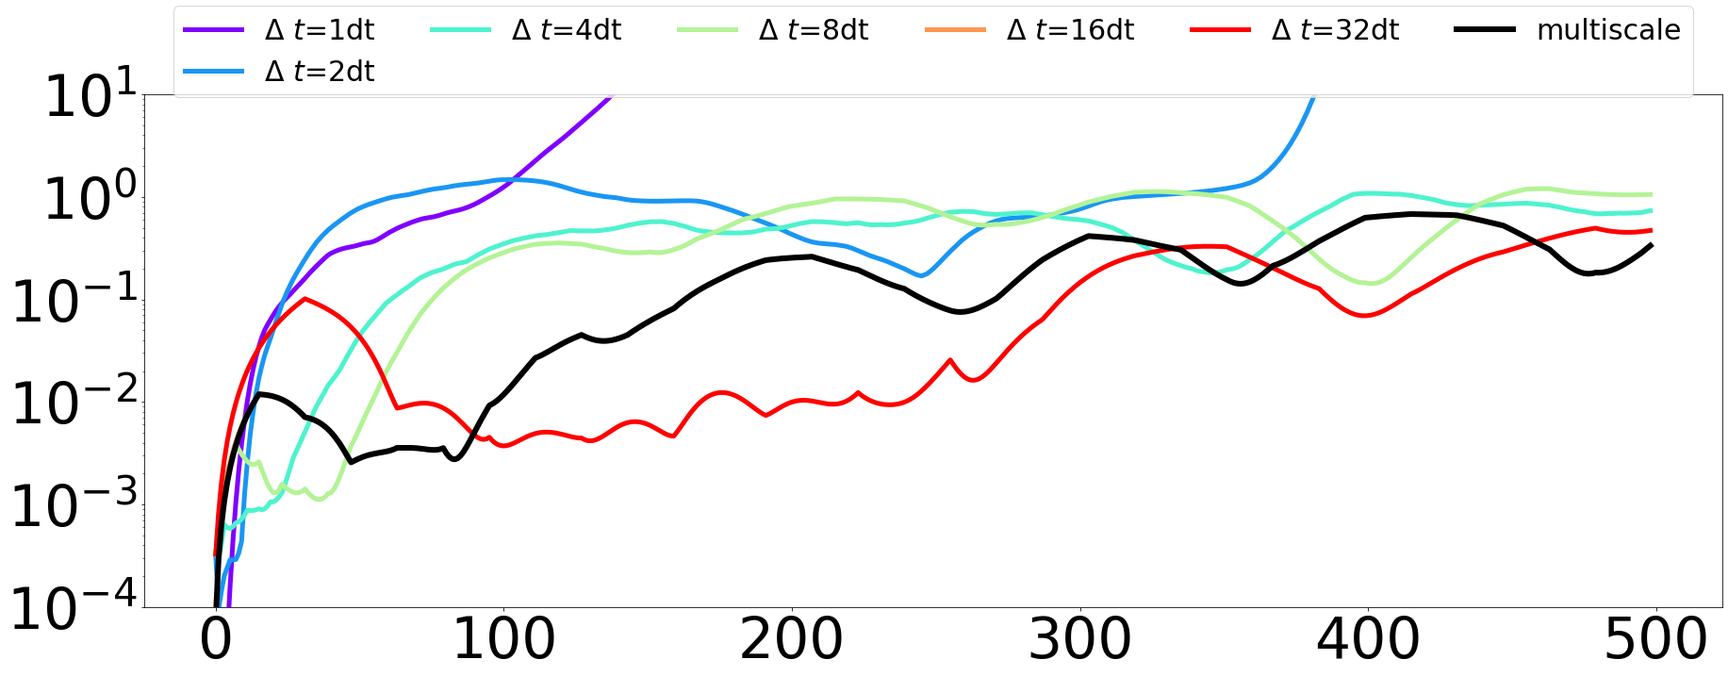
Predicting in time on a 3x3
Only picked model 4
The cross validation is only picking 1 timescale to use
3x3 data is using the average of each block

Slide 10
In MrCAE
In MrCAE, there are levels and stages.
For toy1, 3 levels, 4 stages per level:
archs = [[1,2,3,4],[1,2,3,4],[1,3,5,7]]
Levels are more refined,
But what are the stages?
We basically cut in half the areas that are still high error.

Slide 11
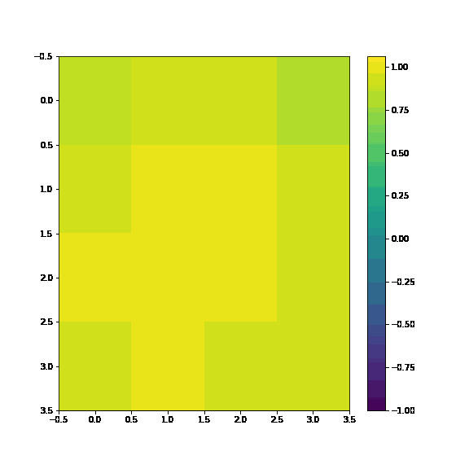
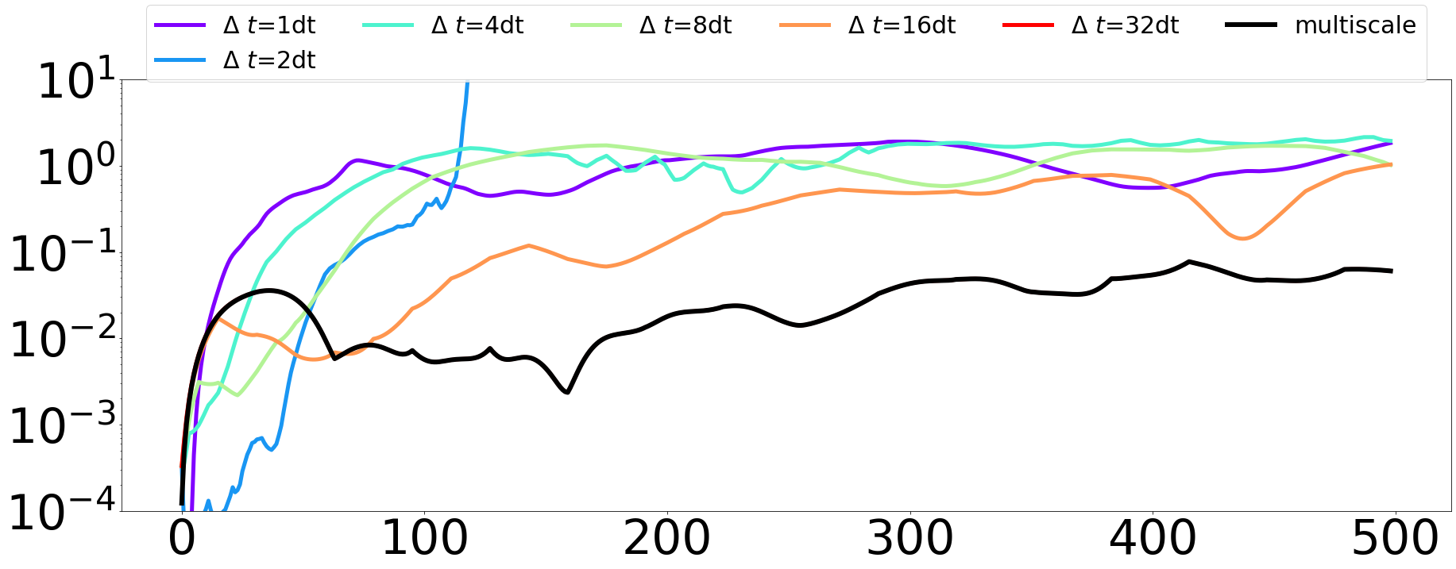
4x4 is also only picking largest time step

Slide 12
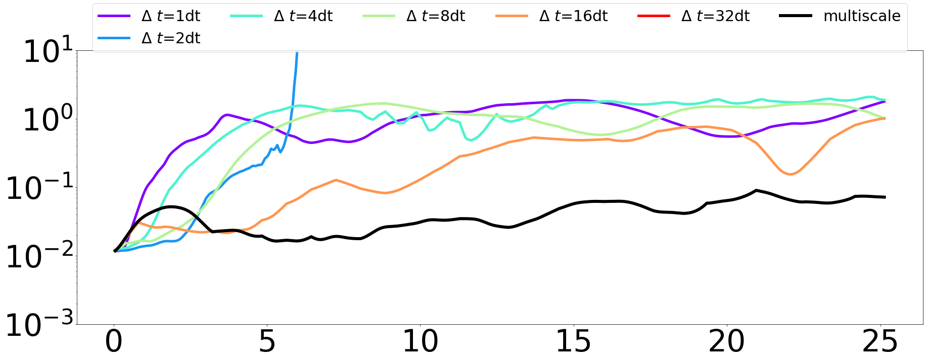
Error is 124x124 space

Slide 13
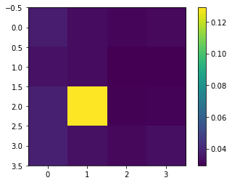
Average mse on 4x4

